Slide 1
Microbial metagenomics
Alise Ponsero

Slide 2
What you can expect today…
Intro: What is the human microbiome and why should I even care?
Case study 1: Microbiota dysbiosis in honeybee
Case study 2: Novel biomarkers for Ulcerative Colitis
Case study 3: Non-invasive characterization of lung infections in CF patients
At the end of this presentation, you should :
Be able to discuss why human microbiome studies are relevant to medical research
Be able to cite the main microbial metagenomics sequencing approaches and their pros/cons
Be able to explain the main types of analysis routinely conducted on microbial metagenomes

Slide 3
What is a microbiome and why should I even care?

Slide 4
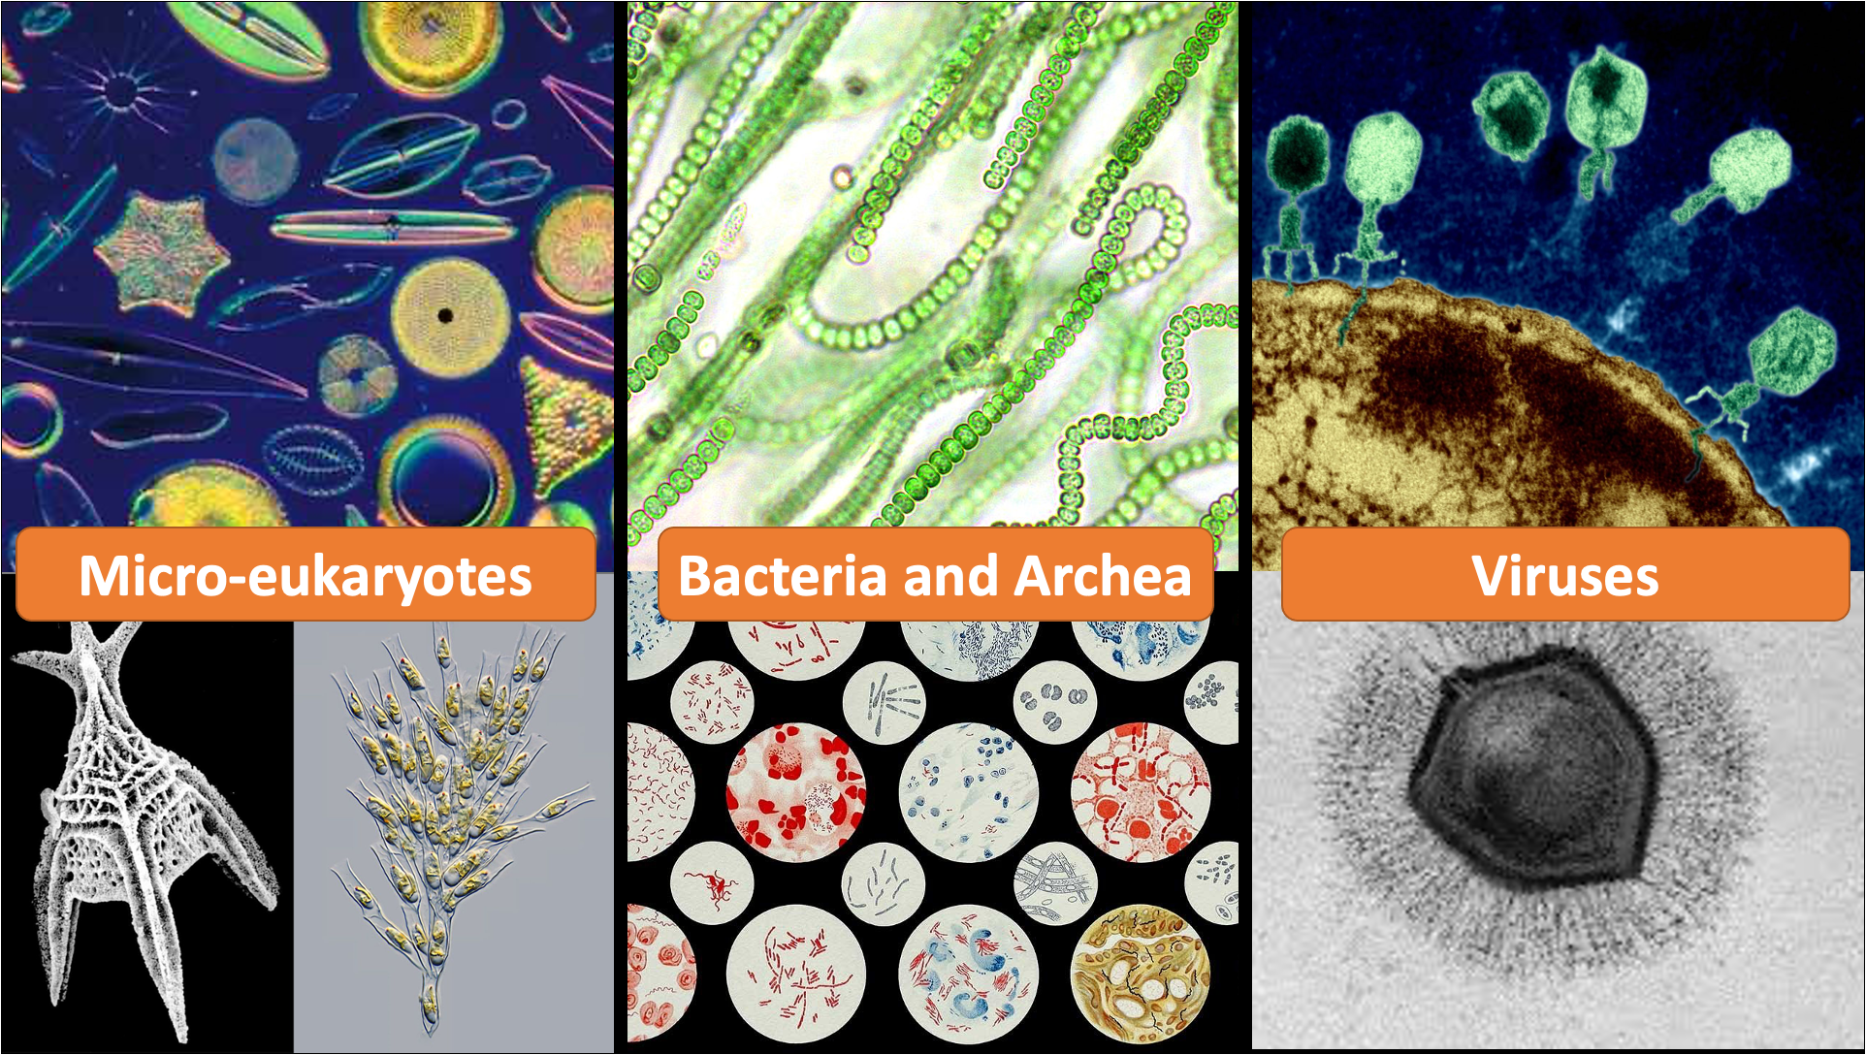
What is a microbiome?
A microbiome is a complex mixture of microorganisms that reside in a specific environmental niche.
OHMI: https://doi.org/10.1186/s13326-019-0217-1
Notes:
Ontology of Host Microbe interactions

Slide 5
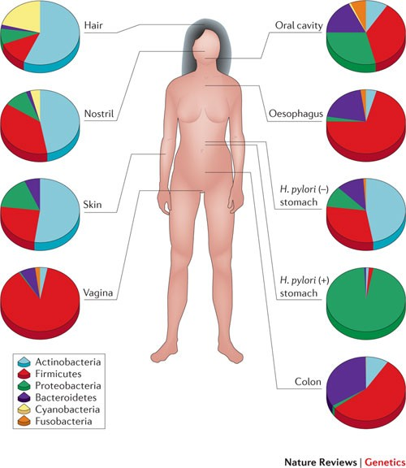
What is the human microbiome ?
The human microbiome is the ecological community of commensal, symbiotic, and pathogenic microorganisms that literally share our body space.
HMP: https://doi.org/10.1038/nature06244
From https://doi.org/10.1038/nrg3182

Slide 6
What is the human microbiome ?
The human body contains
at least 1000 different species of prokaryotes
carries 150 times more microbial genes than human genes
Microbiota composition differ according to different locations, age, sex, genetic background, and diet of the host
From https://doi.org/10.1038/nrg3182

Slide 7

The human microbiome is an essential organ whose function are central to human health
Microbial metagenomics allows to explore the complex interaction between microbiota and host health
@thescientist

Slide 8

Why do we care about the human microbiome?
Detection of a pathogen leading to disease state
Assessment of treatment method efficiency
e.g. Diabetic foot ulcer
Notes:
So there are a lot of different questions and applications tied to better understanding the human microbiome. As an example

Slide 9
Why do we care about the human microbiome?
Detection of an infection leading to disease state
Assessment of treatment method efficiency
e.g. Diabetic foot ulcer
Open wound
Contamination
infected wound
Notes:
DFU are a common complication of diabetes that severely affect a patient’s quality of life and often lead to lower limb amputation
5-year mortality for diabetic foot ulcers : 30.5%

Slide 10
Why do we care about the human microbiome?
Detection of an infection leading to disease state
Assessment of treatment method efficiency
e.g. Diabetic foot ulcer
Debridement treatment
Antibiotherapy
Open wound
Contamination
infected wound
Colonization and
Biofilm formation
chronic wound
Poor blood flow and healing
Notes:
DFU are a common complication of diabetes that severely affect a patient’s quality of life and often lead to lower limb amputation
5-year mortality for diabetic foot ulcers : 30.5%

Slide 11
Why do we care about the human microbiome?
Detection of an infection leading to disease state
Assessment of treatment method efficiency
e.g. Diabetic foot ulcer
Debridement treatment
Antibiotherapy
Healed
wound
What are the microbiological factors that are associated to poor outcomes?
How does the wound microbiota change during treatment? What type of community changes are associated to wound healing?
chronic wound
Limb Amputation
Notes:
DFU are a common complication of diabetes that severely affect a patient’s quality of life and often lead to lower limb amputation
5-year mortality for diabetic foot ulcers : 30.5%

Slide 12
Why do we care about the human microbiome?
Novel biomarker of diseases
e.g. Colo-Rectal Cancer
Notes:
Another area of research for human microbiome and health is the development of microbial biomarkers for long term diseases such as certain type of cancer.
Colorectal cancer is one of the most common cancers and is a major global health burden.
Third cancer in terms of incidence and second in mortality worldwide

Slide 13
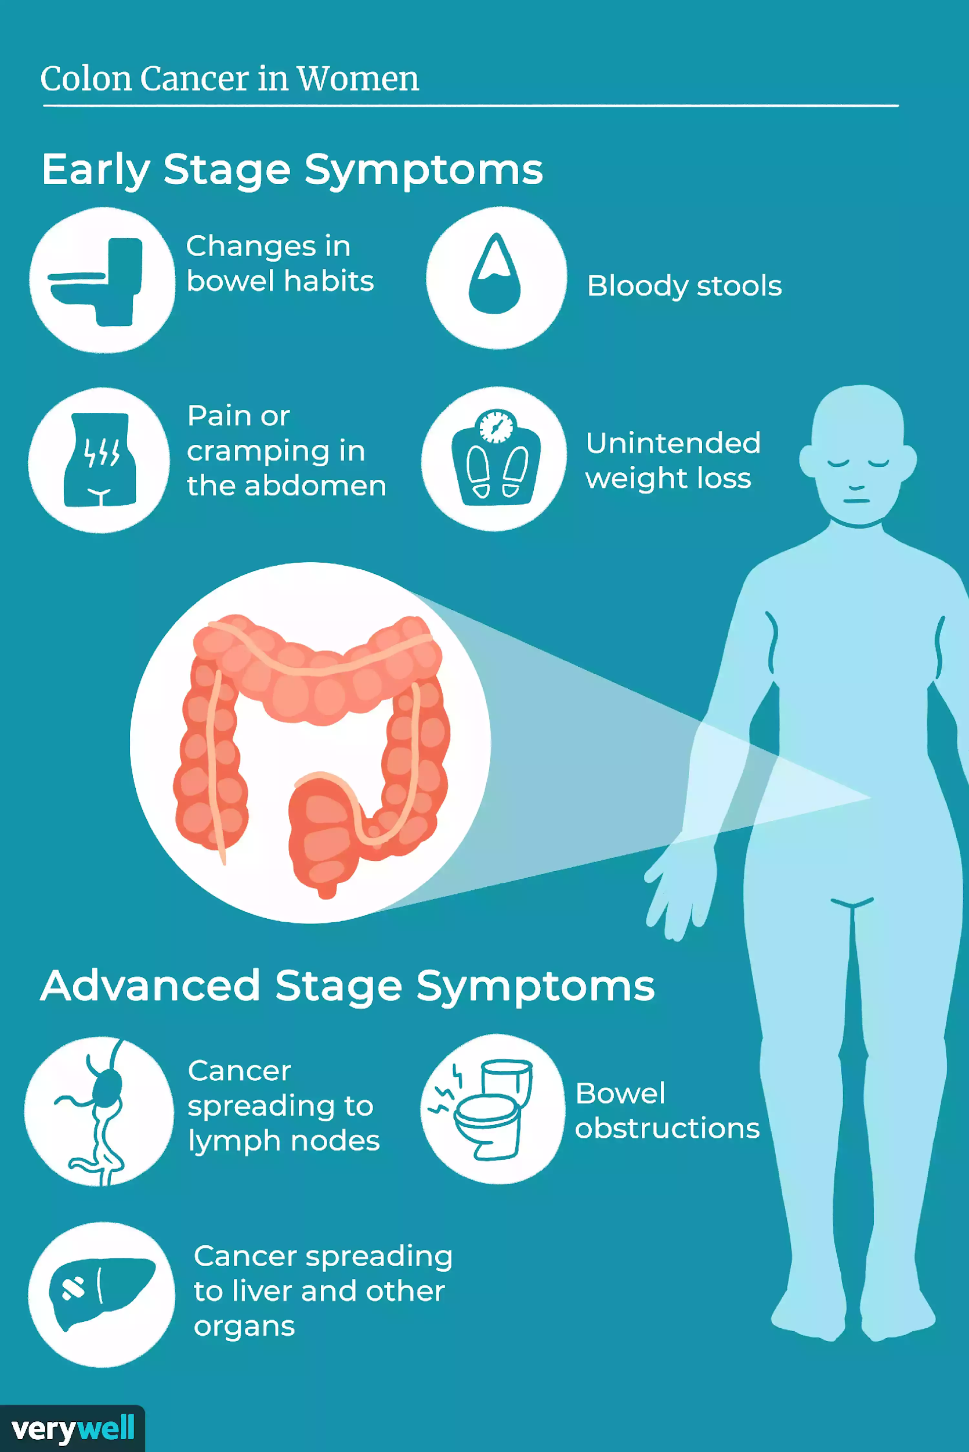
Why do we care about the human microbiome?
Novel biomarker of diseases
e.g. Colo-Rectal Cancer
Early detection of CRC is challenging
Notes:
Colorectal cancer is one of the most common cancers and is a major global health burden.
Third cancer in terms of incidence and second in mortality worldwide

Slide 14
Why do we care about the human microbiome?
Novel biomarker of diseases
e.g. Colo-Rectal Cancer
Early detection of CRC is challenging
Can we identify early changes in the fecal microbiota composition that would sign the development of CRC?
Notes:
Can we use fecal microbiota composition as an non-invasive early CRC biomarker?

Slide 15

Why do we care about the human microbiome?
Central role in personalized medicine approaches
e.g. Response to treatments

Slide 16
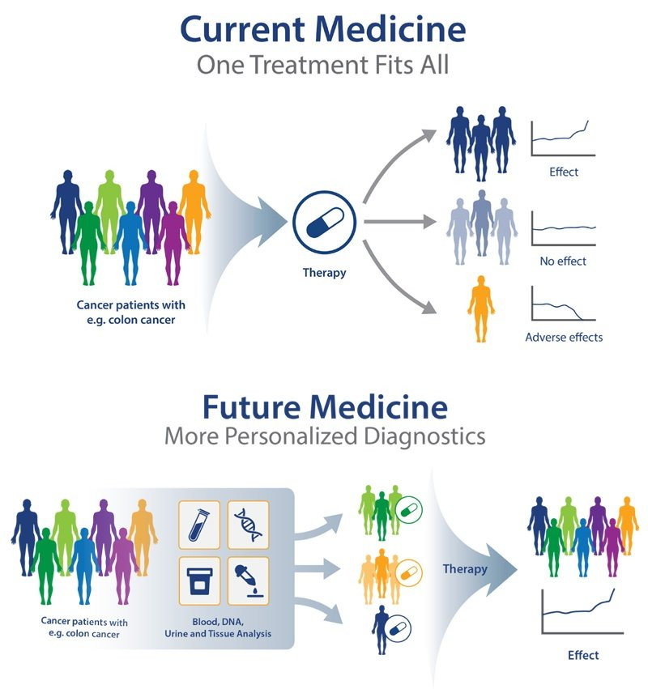
Why do we care about the human microbiome?
Central role in personalized medicine approaches
e.g. Response to treatments
The gut microbiota can influence the metabolism of pharmaceuticals,
changing their efficacy and/or side effect profiles

Slide 17
Why do we care about the human microbiome?
Central role in personalized medicine approaches
e.g. Response to treatments
Blood type, Human genotype, microbiome composition
Considering the patient’s unique microbiota, can we provide a personalized medicine treatment that ensure best care for everyone?

Slide 18
Why do we care about the human microbiome?
Detection of an infection leading to disease state
Assessment of treatment method efficiency
e.g. Diabetic foot ulcer
Who is there?
What is the microbial species composition?
How dynamic through time?
How different the composition is between healthy and non-healthy states?
Novel biomarker of diseases
e.g. Colo-Rectal Cancer
Central role in personalized medicine approaches
e.g. Response to treatments

Slide 19
Why do we care about the human microbiome?
Detection of an infection leading to disease state
Assessment of treatment method efficiency
e.g. Diabetic foot ulcer
What are they doing?
What functions these species carries?
What virulence factors can be identified?
What metabolites are produced by the community?
Novel biomarker of diseases
e.g. Colo-Rectal Cancer
Central role in personalized medicine approaches
e.g. Response to treatments

Slide 20
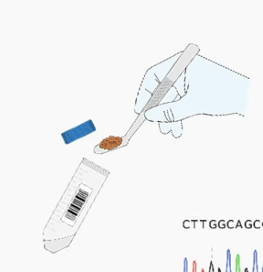
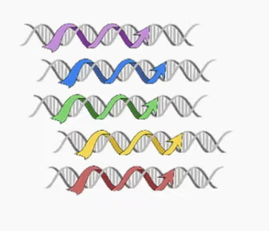
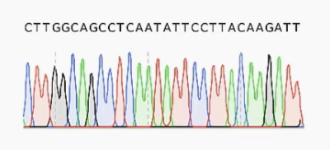
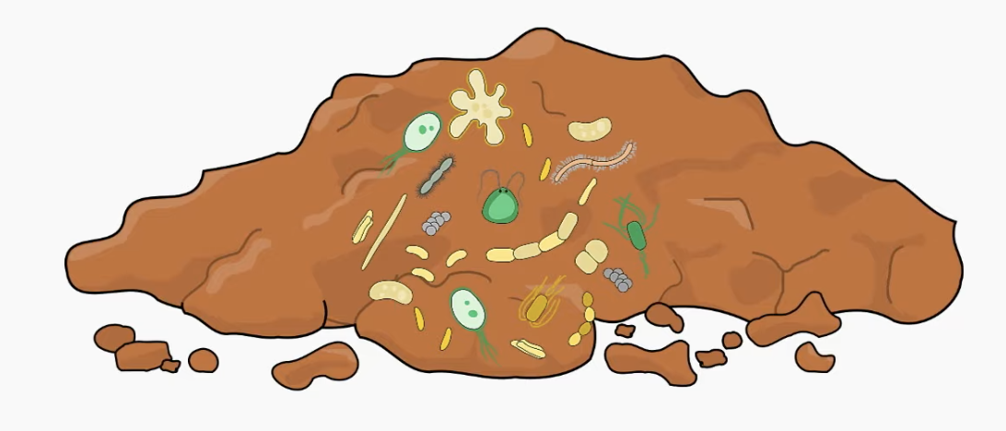
Metagenomics approaches
Metagenomics is the genomic analysis of microbial communities by extracting and sequencing their DNA.
Metagenomics allows to study complex communities of microorganisms directly in their natural environment

Slide 21
Metagenomics approaches
Community composition
Community functions
Metagenomics is the genomic analysis of microbial communities by extracting and sequencing their DNA.
Metagenomics allows to study complex communities of microorganisms directly in their natural environment

Slide 22
Community composition
Community functions
Metagenomics is the genomic analysis of microbial communities by extracting and sequencing their DNA.
Metagenomics allows to study complex communities of microorganisms directly in their natural environment

Slide 23
Case 1: Microbiota dysbiosis in honeybee (Apis mellifera L.) larvae infected with brood diseases

Slide 24
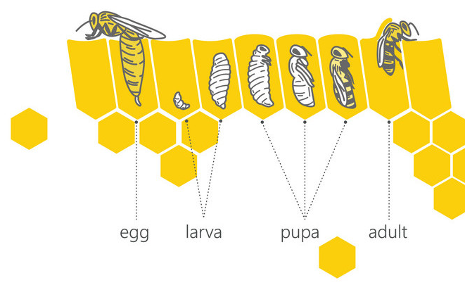
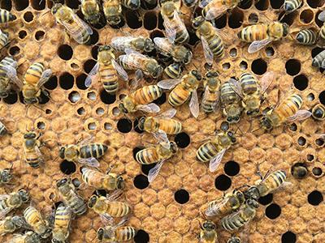
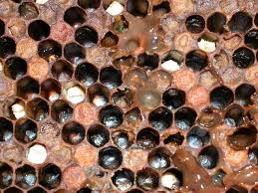
Context
Normal Brood
Infected Brood
American foulbrood (AFB) disease:
disease caused by Paenibacillus larvae that can wipe out honeybee broods and cause substantial economic losses to beekeepers
several honeybee behaviors such as honey robbing and adult workers drift can cause the disease to spread between beehives
honeybee gut microbiota is involved in hosts' metabolism, development and immunity
🡪 Characterization of the disease and its impacts on bee microbiota

Slide 25

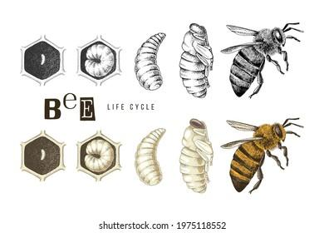
Experimental setup
Hives located in the villages of Yangzhou city, China
One hive suspected of being infected with AFB disease
Other hives didn’t display any sign of infection
Collection of:
6 infected larvae
6 considered healthy larvae
Notes:
During a regular afternoon check of colonies, the experienced beekeeper noticed faint and unfavourable odour emitting from one examined frame. A further examination revealed that the source of the odour was sporadic larvae (aged from 48 to 96 h old) in brood nests which were darker than the normally translucent and lustrous larvae.

Slide 26
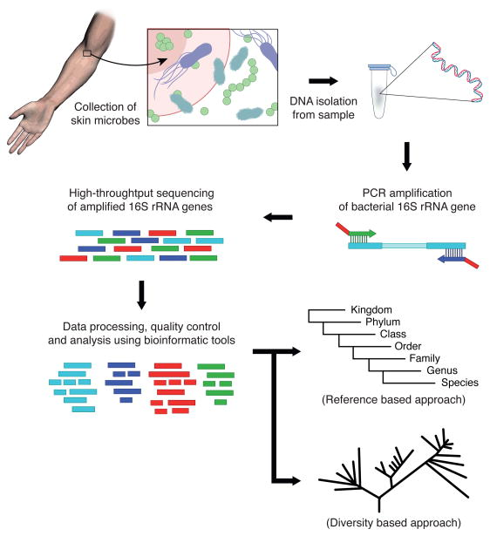
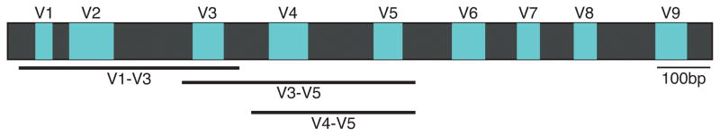
16S rRNA amplicon sequencing
16S rRNA gene

Slide 27


Experimental setup
ATCGGTTAGGTAGATGA
ATCGGTTAGGTAGATGA
ATTGGTTAGGTATATGA
ATTGGTTAGGTATATGA
ATTGGTTAGGTATATGA
ATTGGGGAGGTAGATGA
ATTGGGGAGGTAGATGA
ATTGGGGAGGTAGATGA
ATTGGGGAGGTAGATGA
OTU1
ATCGGTTAGGTAGATGA
ATCGGTTAGGTAGATGA
ATTGGTTAGGTATATGA
ATTGGTTAGGTATATGA
ATTGGTTAGGTATATGA
ATTGGGGAGGTAGATGA
ATTGGGGAGGTAGATGA
ATTGGGGAGGTAGATGA
ATTGGGGAGGTAGATGA
ATTGGGGAGGTAGATGA
ATCGGTTAGGTAGATGA
ATTGGTTAGGTATATGA
ATTGGGGAGGTAGATGA
ATTGGTTAGGTATATGA
ATCGGTTAGGTAGATGA
ATTGGTTAGGTATATGA
ATTGGGGAGGTAGATGA
ATTGGGGAGGTAGATGA
Staphylococcus sp.
OTU2
Pseudomonas sp.
OTU3
Corynebacterium sp.
All amplicon sequences
OTU picking at 97% similarity
Taxonomic annotation

Slide 28
Microbiome data characteristics
 | larvae 1 | larvae 2
Staphylococcus | 156 | 762
Pseudomonas | 350 | 241
Corynebacterium | 67 | 50
Notes:
So, if we take this very simple example where we are trying to study two ecosystem’s microbial composition using a metagenomic approach.
It means that, from the complete microbial community in the ecosystems, the method will sample a subpart of the total community, and sequence it. After analysis of the reads of out your sequencer, you will have something like this count table, for which each sample will have some counts for for each taxa found in the ecosystem.

Slide 29
Microbiome data is inherently compositional
 | larvae 1 | larvae 2
Staphylococcus | 156 | 762
Pseudomonas | 350 | 241
Corynebacterium | 67 | 50
sum | 573 | 1003
Absolute counts are not biologically informative
Notes:
Another very important concept it that the read counts observed in a sequencing run are not biologically informative. They are rather a random sample of the relative abundance of the taxa taken from the underlying ecosystem.
So, these count can not be related to the absolute number of taxa in the original ecosystem.

Slide 30
Microbiome data is inherently compositional
 | larvae 1 | larvae 2
Staphylococcus | 27% | 76%
Pseudomonas | 61% | 24%
Corynebacterium | 12% | 5%
sum | 100% | 100%
Absolute counts are not biologically informative
Notes:
Another very important concept it that the read counts observed in a sequencing run are not biologically informative. They are rather a random sample of the relative abundance of the taxa taken from the underlying ecosystem.
So, these count can not be related to the absolute number of taxa in the original ecosystem.

Slide 31
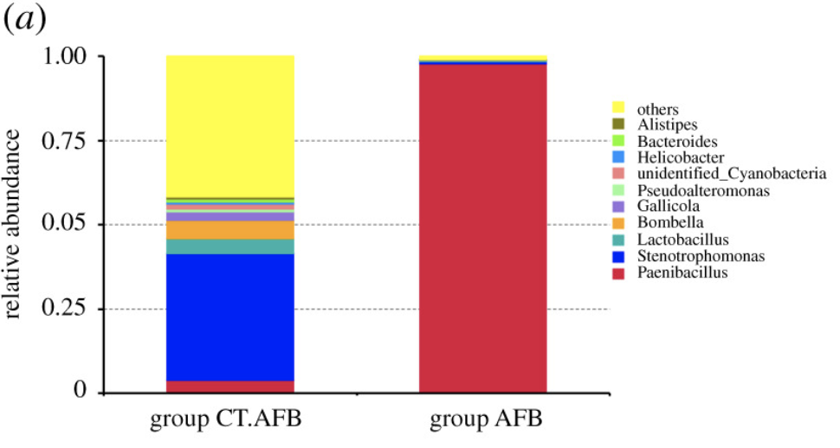
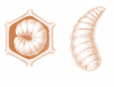
Results
6 healthy larvae
Average profile composition for healthy larvae
6 AFB larvae
Average profile composition for AFB larvae
As expected, the AFB larvae present a microbiota completely dominated by Paenibacillus.
However, Paenibacillus can also be found in healthy larvae

Slide 32
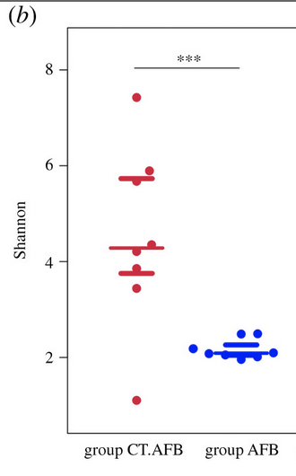
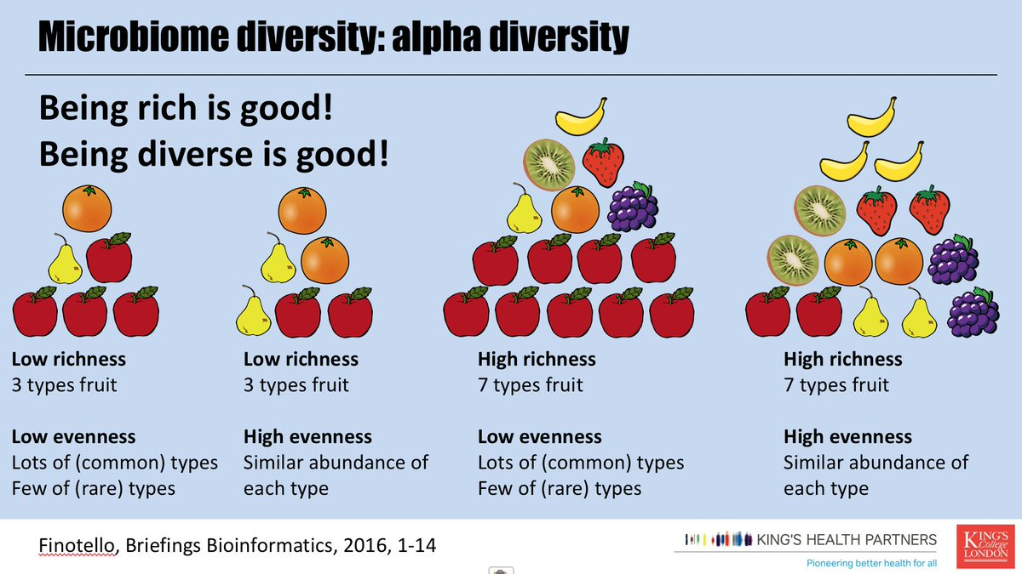
Results
AFB larvae present a microbiota with lower alpha diversity than healthy larvae, suggesting a microbiota dysbiosis
Notes:
Different higher-level measures are often used to describe the microbiome in a sample. These do not provide information on changes in abundance of specific taxa, but allow us to access a broader change or difference in the composition of microorganisms. Alpha adiversity is one of these important measures.
Different measures exist to estimate diversity within ONE sample, jointly called alpha diversity. The different measures reflect the richness (number) or distribution (evenness) of a microbial sample, or aim to reflect a combination of both properties.

Slide 33
Conclusions
Data from high throughput sequencing of 16S rRNA gene amplicons enabled the authors to analyze the structure of microbial composition in larvae under different physiological conditions
Infection by AFB in larvae cause a drastic change of composition of the larvae microbiota
AFB larvae microbiota is characterized by a low diversity and a high relative abundance of P. larvae
Healthy larvae microbiota is characterized by a high diversity and a high relative abundance in Lactobacillus (genus beneficial to its hosts through the production of antimicrobial metabolites and peptides, as well as through the modulation of immune response)
P. larvae can also be found in lower abundance in presumed healthy larvae , suggesting that P. larvae may persist as asymptomatic infections in these presumed healthy colonies.

Slide 34
Case 2: Novel Fecal Biomarkers That Precede Clinical Diagnosis of Ulcerative Colitis

Slide 35
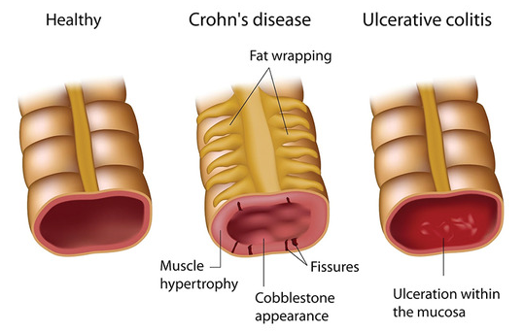
Context
Ulcerative Colitis (UC)
Is a chronically relapsing forms of IBD
there is currently no cure and the exact cause of is unknown
Previous studies showed microbial changes in patients with UC vs healthy patient (Reduced diversity and increase Firmicutes)
🡪 most studies have examined patients with active or treated disease, what are the microbial compositional or functional changes that occur before disease onset.
Notes:
Ulcerative colitis is a long-term condition where the colon and rectum become inflamed.
The colon is the large intestine (bowel) and the rectum is the end of the bowel where stools are stored.
Small ulcers can develop on the colon's lining, and can bleed and produce pus.
The main symptoms of ulcerative colitis are:
recurring diarrhea, which may contain blood, mucus or pus, pain, and needing to empty your bowels frequently
You may also experience extreme tiredness (fatigue), loss of appetite and weight loss.
The severity of the symptoms varies, depending on how much of the rectum and colon is inflamed and how severe the inflammation is.
For some people, the condition has a significant impact on their everyday lives.

Slide 36
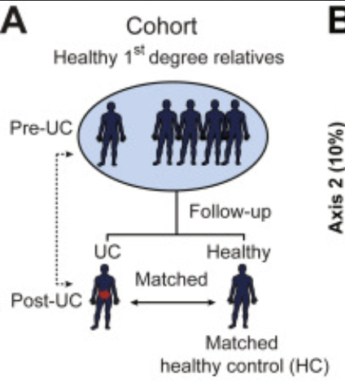
Experimental setup
Participants were recruited as part of the longitudinal Genetics, Environmental, Microbial (GEM) project.
2008: Pre-UC sample collection
between 6 and 35 years of age
Healthy and no IBD symptoms
High risk for IBD (1rst degree relative with IBD)
2018: Follow-up
10 participants developed UC
Matched with participants that did not develop UC
Collection of stool samples
Collection of stool samples

Slide 37
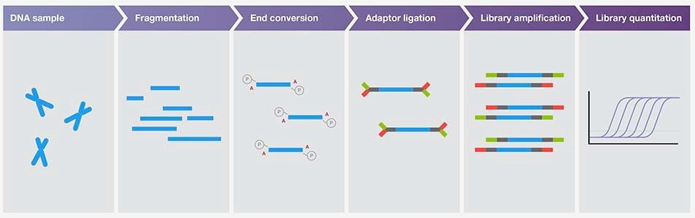
Whole genome shotgun sequencing
sequencing
ATTCTGATATGATAG
ATTCTGATATGATAG
ATTCTGATATGATAG
ATTCTGATATGATAG
ATTCTGATATGATAG
Notes:
https://www.youtube.com/watch?v=-kTcFZxP6kM&ab_channel=AppliedBiologicalMaterials-abm
3’ ends are adenylated allowing the hybridization with the sequencing adaptors. These adaptors will allow the DNA fragments to hybridize to the surface of the sequencing chip. The collection of adapter-ligated DNA fragments forms what we call a library which is sequenced

Slide 38
Experimental setup
mapping
Genomes
reference
Sequencing read
ATTGCTGGTAAGTCAATGT
Taxonomic annotation
Bacteroides fragilis
mapping
Gene families
Sequencing read
ATTGCTGGTAAGTCAATGT
functional annotation
alcohol dehydrogenase

Slide 39
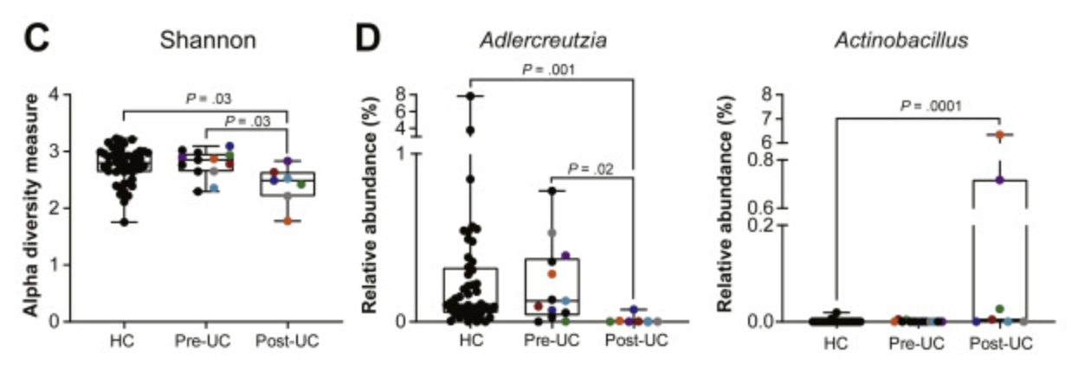
Results
Microbiota Composition of Post–UC Participants Differs From Healthy Control and Pre–UC Participants
Post-UC has a reduced alpha-diversity
Post-UC has an increased relative abundance of Actinobacillus species

Slide 40
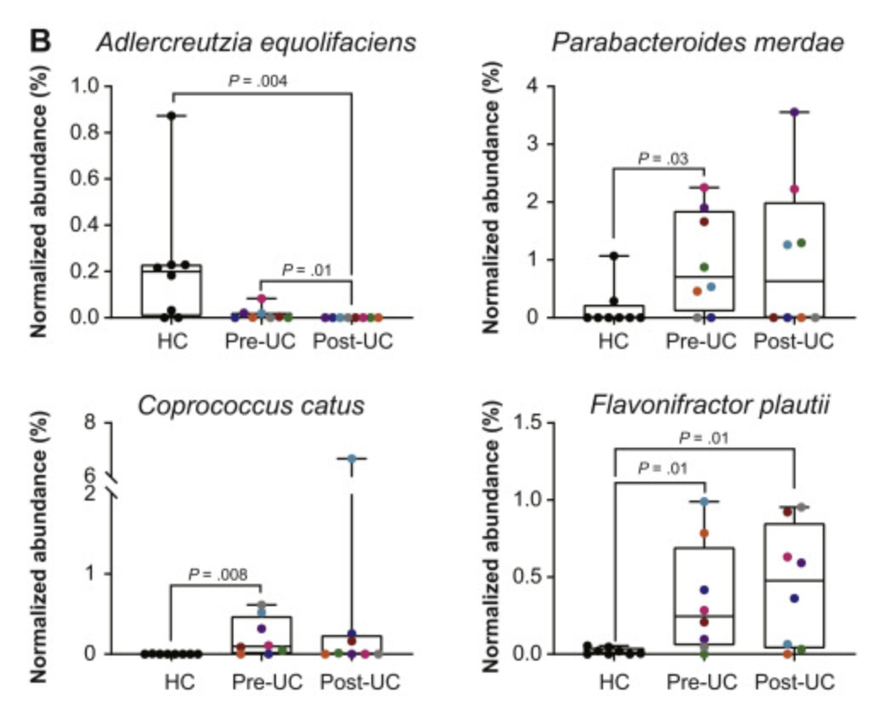
Results
Identification of biomarkers for risks of developing UC:
Pre-UC samples has reduced abundance of Adlercreutzia equolifaciens compared to HC
Pre-UC samples has increased abundance of Parabacteroides merdae, Coprococcus catus and Flavonifractor plautii compared to HC

Slide 41
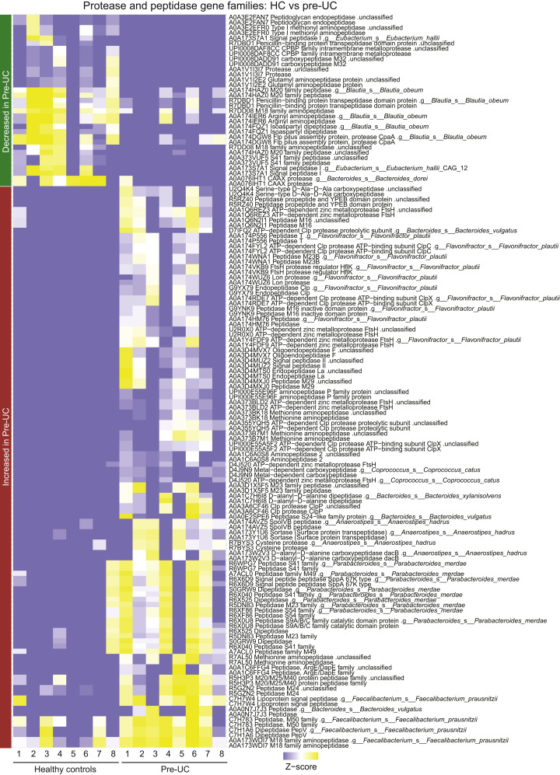
Results
Microbial Function Is Altered in Pre–UC Microbiota
The analysis of metagenomic data identified more than 22,000 bacterial gene families that differed between pre-UC and HC and between pre-UC and post-UC samples.
Of these, 237 unique gene families were associated with protease and peptidase functions

Slide 42
Conclusions
Data from WGS enabled the authors to identify taxa and functions that can be used as early biomarker for the development of UC
Patient with UC have a different microbiota composition than healthy controls
By looking at the microbiota composition in these patient BEFORE the development of UC allows the authors to :
Identify taxa that are differentially abundant in heathy patients that will or will not develop UC later in life
Identify microbiota functions that are altered in healthy patients that will develop UC

Slide 43
Case 3: Sputum DNA sequencing in cystic fibrosis: non-invasive access to the lung microbiome and to pathogen details

Slide 44
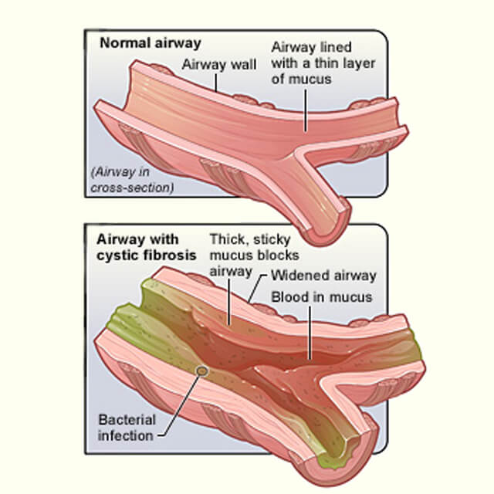
Context
Cystic fibrosis (CF):
Autosomal recessive condition affecting about one in 2500 newborns
affects mostly secretory organs, such as the pancreas, liver, and lungs
The condition is characterized by an accumulation of extracellular mucus in the airways, leading to microbial pathogen colonization in the lung
the condition leads to progressive pulmonary damage and eventually respiratory failure and death
🡪 Rapid identification and characterization of bacterial pathogen is critical to put in place an adapted antimicrobial treatment
https://www.hopkinsmedicine.org/

Slide 45


Experimental setup
Sputum samples collected from:
6 CF patients
4 chronic obstructive pulmonary disease patients
7 healthy controls
3 smokers, 4 non-smokers

Slide 46
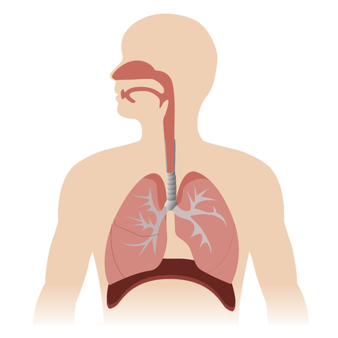


Experimental setup
Sputum
DNA extraction
WGS
sequencing

Slide 47
Experimental setup
Sequencing read
ATTGTCTACAATTATCG
ATTATCGGTGTAGGA
GTGTATTGAAATTATCG
AATTATCGGTATTGATT

Slide 48
Experimental setup
Sequencing read
Assembly in contig
Taxonomy
ATTGTCTACAATTATCG
ATTATCGGTGTAGGA
ATTGTCTACAATTATCGGTGTAGGA
GTGTATTGAAATTATCG
GTGTATTGAAATTATCGGTATTGATT
AATTATCGGTATTGATT
functions

Slide 49
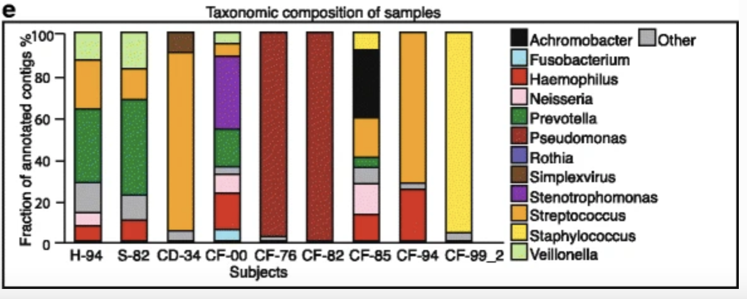
Results
Drastic change between healthy lung microbiota composition and CD/CF patients
Lower diversity in CF and CD patients that in healthy patients
Notes:
The most abundant taxa in healthy subjects were Prevotella, Streptococcus, Veilonella, Haemophilus, and Neisseria (Fig. 1e). Previous studies have indicated that the healthy lung does not harbor a stable and specific microbiome, but rather a mixture of microbes from the upper respiratory tract and oral cavity [21–24]. In agreement, many of the microbes we identified in healthy subjects corresponded to known oral (and occasionally also gastrointestinal or vaginal) flora.

Slide 50
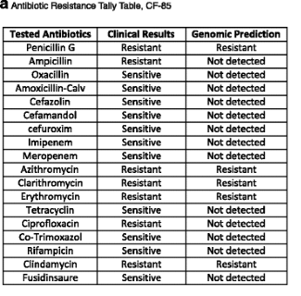
Results
Can sputum sequencing help to guide antibiotic treatment ?
screened for the presence of putative resistance-conferring genes and alleles
predictions validated by comparing to clinical resistance reports
The majority of both “resistant” as well as “non-resistant” calls were confirmed. False predictions were limited to false negatives.
Identification of other virulence genes (defensins resistance, biofilm formation genes..) that are of general relevance to clinicians when designing treatments for CF patients.
Notes:
Chronic colonizers can adapt to their host environment to sustain themselves under varying selection pressures, such as antibiotic treatments or the presence of potentially competing co-infections. This is particularly problematic in the case of infections caused by antibiotic-resistant bacteria in CF patients. For example, a five-fold increase in MRSA infections has been observed in the past 15 years [45], and 18.1% of P. aeruginosa infections in a population of primarily young adult CF patients were reported to be MDR [45]. These pathogens acquire various resistance mechanisms to therapeutic agents including altered membrane permeability, efflux pumps, or induced enzymatic modifications. Isolates with identical resistance patterns sometimes exhibit different genetic modifications, indicating that these bacteria can use distinct strategies to respond to similar environmental pressures

Slide 51
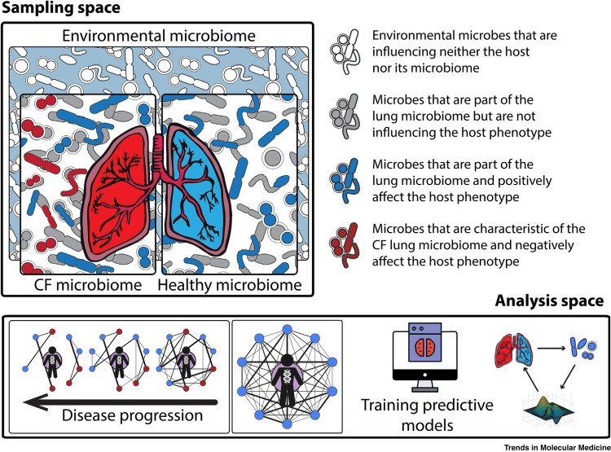
Conclusions
Culture-independent technique for characterizing airway pathogens in CF lungs, using routine non-invasive sputum sampling coupled to unbiased WGS sequencing.
They show that WGS sequencing can serve to describe the broad taxonomic composition of the lung microbiome
The assembled contigs could be informative: Antibiotics susceptibility testing is an important part of clinical management, and WGS can help predict antibiotic susceptibility

Slide 52
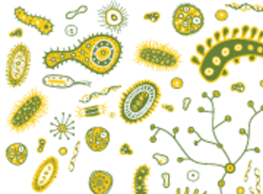
Microbial metagenomic overview
16S rRNA amplicon sequencing
Taxonomic profiling
Prokaryotes only
Alpha-diversity
Differential abundance
Clustering
Pattern learning
WGS
Functional profiling
Etc…

Slide 53
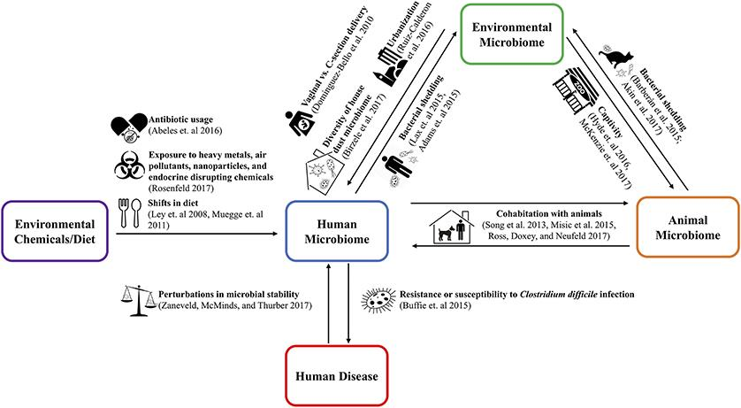
“ONE HEALTH” and microbiota
https://doi.org/10.3389/fpubh.2018.00235
Notes:
The One Health concept stresses the ecological relationships between human, animal, and environmental health. Much of the One Health literature to date has examined the transfer of pathogens from animals (e.g., emerging zoonoses) and the environment to humans. The recent rapid development of technology to perform high throughput DNA sequencing has expanded this view to include the study of entire microbial communities. Applying the One Health approach to the microbiome allows for consideration of both pathogenic and non-pathogenic microbial transfer between humans, animals, and the environment. We review recent research studies of such transmission, the molecular and statistical methods being used, and the implications of such microbiome relationships for human health. Our review identified evidence that the environmental microbiome as well as the microbiome of animals in close contact can affect both the human microbiome and human health outcomes. Such microbiome transfer can take place in the household as well as the workplace setting. Urbanization of built environments leads to changes in the environmental microbiome which could be a factor in human health. While affected by environmental exposures, the human microbiome also can modulate the response to environmental factors through effects on metabolic and immune function. Better understanding of these microbiome interactions between humans, animals, and the shared environment will require continued development of improved statistical and ecological modeling approaches. Such enhanced understanding could lead to innovative interventions to prevent and manage a variety of human health and disease states

Slide 54
Research papers & other ressources
Papers cited:
Case 1: https://doi.org/10.1098/rsos.201805
Case 2: https://doi.org/10.1053/j.gastro.2020.12.004
Case 3: https://doi.org/10.1186/s40168-017-0234-1
To learn more about microbiome studies :
Microbiome digest: https://microbiomedigest.com/
To learn more about microbiome data analysis:
Book: Statistical Analysis of Microbiome Data with R from Yinglin Xia, Jun Sun and Ding-Geng Chen (Springer, 2018 ICSA Book Series in Statistics)
Questions? Contact me at alise.ponsero@helsinki.fi

